Slide 1
Dial in 866-682-4770 Bridge 5341164 passcode 1234

Slide 2


Oracle GoldenGate Microservices
Architecture Deep Dive & Demo
Release 12.3
Rick Michaud
Master Principal Cloud Specialist

Slide 3
Notes:
This is a Safe Harbor Front slide, one of two Safe Harbor Statement slides included in this template.
One of the Safe Harbor slides must be used if your presentation covers material affected by Oracle’s Revenue Recognition Policy
To learn more about this policy, e-mail: Revrec-americasiebc_us@oracle.com
For internal communication, Safe Harbor Statements are not required. However, there is an applicable disclaimer (Exhibit E) that should be used, found in the Oracle Revenue Recognition Policy for Future Product Communications. Copy and paste this link into a web browser, to find out more information.
http://my.oracle.com/site/fin/gfo/GlobalProcesses/cnt452504.pdf
For all external communications such as press release, roadmaps, PowerPoint presentations, Safe Harbor Statements are required. You can refer to the link mentioned above to find out additional information/disclaimers required depending on your audience.

Slide 4
Agenda
Overview
Architecture
Directory Structure
RESTful API

Slide 5






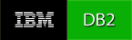










Oracle GoldenGate
Oracle GoldenGate provides low-impact capture, routing, transformation, and delivery of database transactions across homogeneous and heterogeneous environments in real-time with no distance limitations.
Most Databases
Cloud
Data Events
Transaction Streams
Big Data
Real time Performance
DBs
Extensible & Flexible
* The most popular enterprise integration tool in history
Proven & Reliable
Supports Databases, Big Data and NoSQL:
Notes:
Virtually every company will approach its journey to Cloud from a distinct point of view, based on an individual history and circumstances
Our own four-decade history means Oracle has seen it all
And when it comes to enabling the journey to Cloud, we can provide a path from any starting point
Supports new cloud, existing environments, and hybrid
Supports all workloads, all developers, and all data
Connects all applications and business practices
Goes beyond migrate - Run, Manage, Support
Provide Lifetime Value
What do we mean when we talk about providing lifetime value?
ADDITIONAL
Also, innovation goes to HOW we delivered this.
I would say that you have to look at the challenges that enterprises are facing in adopting this new delivery model of the public cloud. First and foremost, is the challenge that the technology stack of the cloud is completely different from what enterprises have invested in on prem. Innovation is how we can leverage a customer’s prior investment in technology while allowing them to enjoy the benefits of the new model seamlessly, painlessly. No writing of applications, no modifications of VMs while providing bi-directional portability to the cloud and back. That is innovation. Secondly, allowing customers to leverage their existing IT processes, their architectural blueprints, their complicated network topology in the cloud is innovation. And thirdly, operational excellence in our data centers, allowing incredibly fast performance in all cloud service operations is innovation that only a few if any companies can match Oracle’s ability on.
Not everyone is starting fresh in the Cloud, and in fact, few—if any—customers have this luxury. Most organizations are currently taking some initial steps or just contemplating their first steps.
Their first steps they do make In the Cloud are services that need to co-exist within current environments and investments.
New applications need to interoperate with on-premises applications. New forms of doing business need to co-mingle with existing business processes.
Just as important as providing solutions is providing a path. Otherwise you and me are no different from many of the Cloud competitors out there.
There are multiple roads a customer can take in the journey to the Cloud.
With Oracle there isn’t just one solution or one path to the Cloud. Only Oracle offers a full technology continuum to enable customers wherever they might be on that journey. We can…
Support new cloud, existing environments and hybrid
Support all workloads, all developers, and all data
Connect all applications and business practices
Go beyond migrate – Architect, Run, Manage, Support
Provide Lifetime Value
And what do I mean by provide lifetime value??

Slide 6
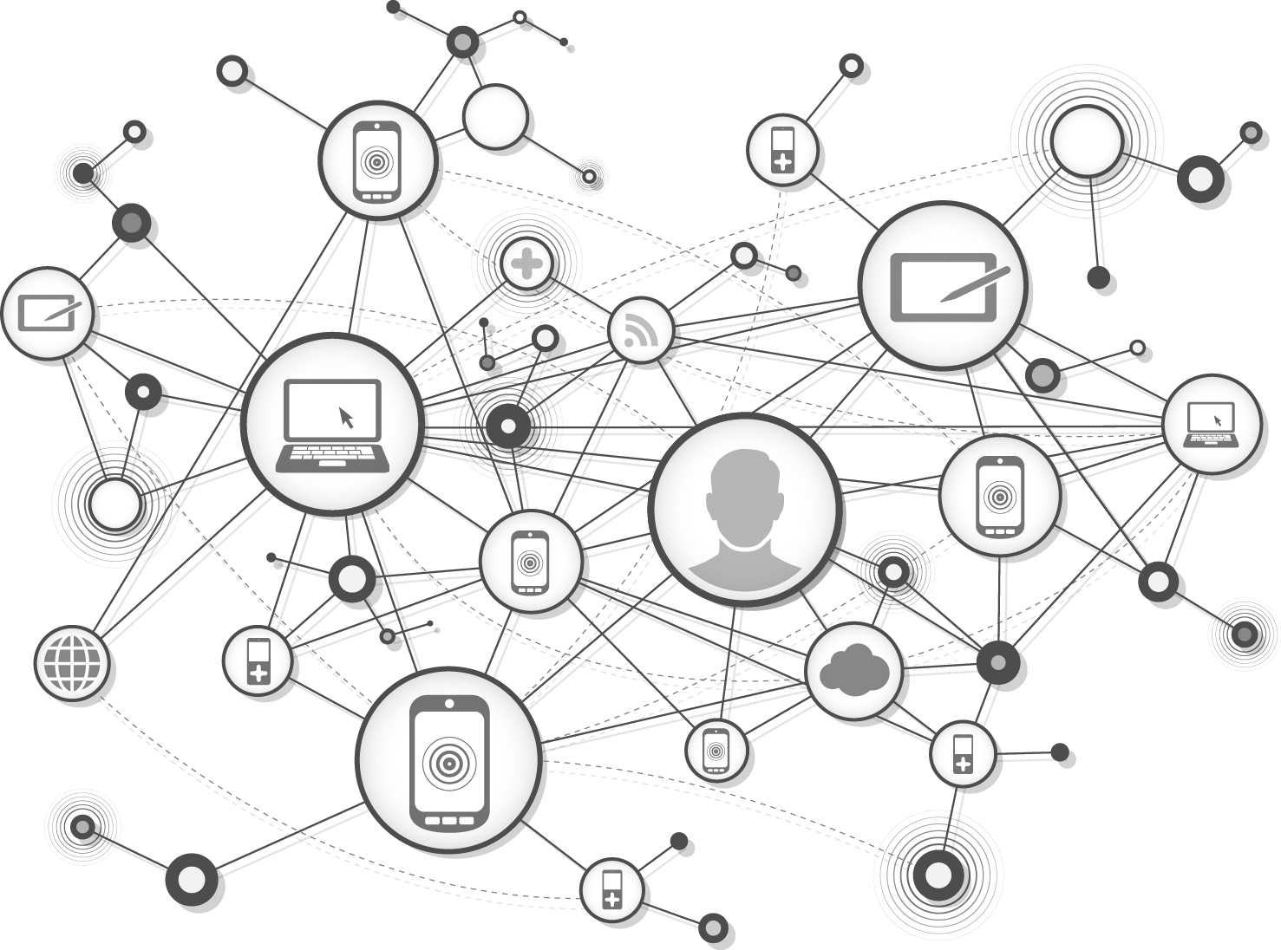
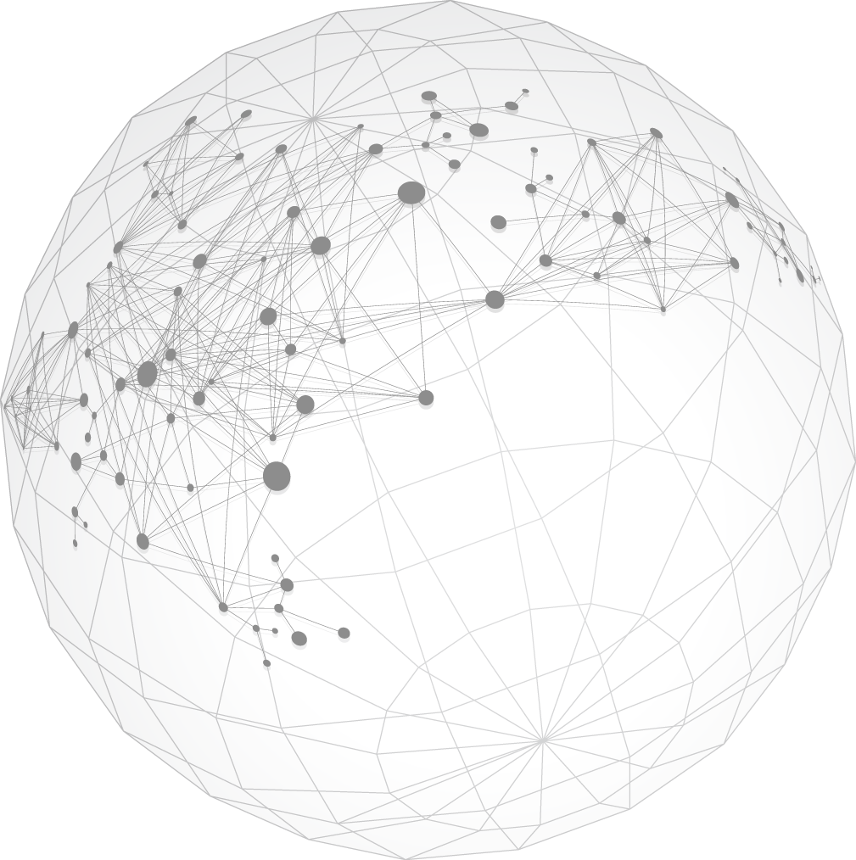
Oracle GoldenGate 12.3 Features
New GoldenGate Services Architecture
REST interfaces for Configuration, Administration and Monitoring with included HTML5 Web applications
Deploy at cloud scale with fully secure HTTPS interfaces and Secure Web Sockets for streaming data
Parallel Apply
Highly scalable client side apply engine with gains of over 5x throughput on Oracle
Automatic Conflict Detection and Resolution (CDR)
Conflict detection and resolution built directly into Oracle Database Kernel
Oracle Database Sharding Support
Embedded & fully automated active-active replication within and across Database Shards
Cloud
Integrated UI for Design, Development, Management and Monitoring for GoldenGate Cloud Service
Expanded Oracle Database 12.2 Support
Long identifiers, Expanded SCN, Local Undo for PDBs, Top-level VARRAYs, REFs.
Procedural replication of Advanced Queues, Virtual Private Database, Online Redefinition, ….
Enhanced Big Data and NoSQL Support
Sample adapters for Oracle NoSQL, MongoDB. Support for Hive Metadata
Heterogeneous Enhancements
Generic JDBC Support. MySQL DDL replication. Remote capture and apply for z/OS

Slide 7
Agenda
Overview
Architecture
Directory Structure
RESTful API

Slide 8
GoldenGate 12c Microservices Architecture Overview
Simplifies large scale and cloud deployments
GoldenGate components implanted as as decoupled services with comprehensive RESTful interfaces.
Enables remote and secure configuration, administration, and monitoring capabilities.
Enables Applications to embed, automate, and orchestrate GoldenGate.

Slide 9


Microservices Architecture for Cloud and Large-scale Deployments
Administration, Distribution, Receiver, Metrics Services with RESTful Service Interfaces
HTTPS RESTFul Service Interfaces
Admin Server
Admin Server
Source
Database
Target
Database
Metrics Server
Metrics Server
Distribution Service
Receiver Service
Trail Files
Extract
Trail Files
Replicat
Service Manager
Service Manager
Source
Target

Slide 10
New GoldenGate Microservices
Administration Service
Replaces GGSCI and Manager with a single administration service for managing replication processes
Multi-threaded Distribution Service
Replaces multiple source-side Extract Pumps with a single instance service.
Lightweight filtering only (no transformations)
Multi-threaded Receiver Service
Replaces the multiple discrete target-side Server/Collectors with a single instance service
Performance Metrics Service
New service for monitoring metrics related to a particular deployment
Also available in the traditional architecture
Service Manager
New service for managing multiple deployments on a local host

Slide 11
Administer GoldenGate with Variety of Clients
Command Line, Browsers, Programmatic RESTful Interfaces
AdminClient
Metrics Server
Browsers
Trail Files
Extract
HTTPS
Distribution Server
Service Interface
PLSQL
Admin Server
Scripts & Interpreters
Service Manager
Anything via
Service IF
Receiver Server
Trail Files
Replicat

Slide 12
Common Key Attributes and Benefits of Each Service
Enables remote configuration, monitoring, and administration
Provides formal RESTful service interfaces
Industry-standard communications protocol: HTTPS, JSON
Enables Applications to Embed GoldenGate
Secure
Authorize identity of clients with username / password or SSL client certificates
Discover
Catalog of all RESTful methods with link based navigation.
Contains an embedded HTML5 application for simple browser based monitoring and administration (no web server needed)

Slide 13



Solutions For Everyone
Administrators
Traditionalists
DevOps
Simple to use Web interfaces
Get up and running quickly
Lower learning curve
Command Line access via adminclient – run anywhere
Similar GoldenGate commands as in GGSCI
Interaction the same as previous releases, just thin client
Uses RESTful APIs
Run anywhere
Roll your own monitoring
Notes:
http://www.istockphoto.com/vector/computer-help-line-vector-icons-set-gm495781011-41027036 (for images to purchase)

Slide 14

Security Model
Standard TLS/SSL based authentication and Client Authorization
Clients
Client Authorization
Identity via SSL user certificates or via username/password
Roles
Security User
Administrator
Operator
User
SSL User Certificate
User/ Passwd
HTTPS
GoldenGate
Services
SSL Server Certificate
Authorized Clients

Slide 15

Cloud Ready
Remote and secure administration and data communication in cloud environments
Internal Network
DMZ
GoldenGate
Services Deployment
Reverse Proxy
HTTPS
GoldenGate
Services Deployment
wss
Remote Administration and Configuration
No OS access required after installation
Secure administration and data transport
Works with all standard HTTP proxy and reverse proxy servers

Slide 16
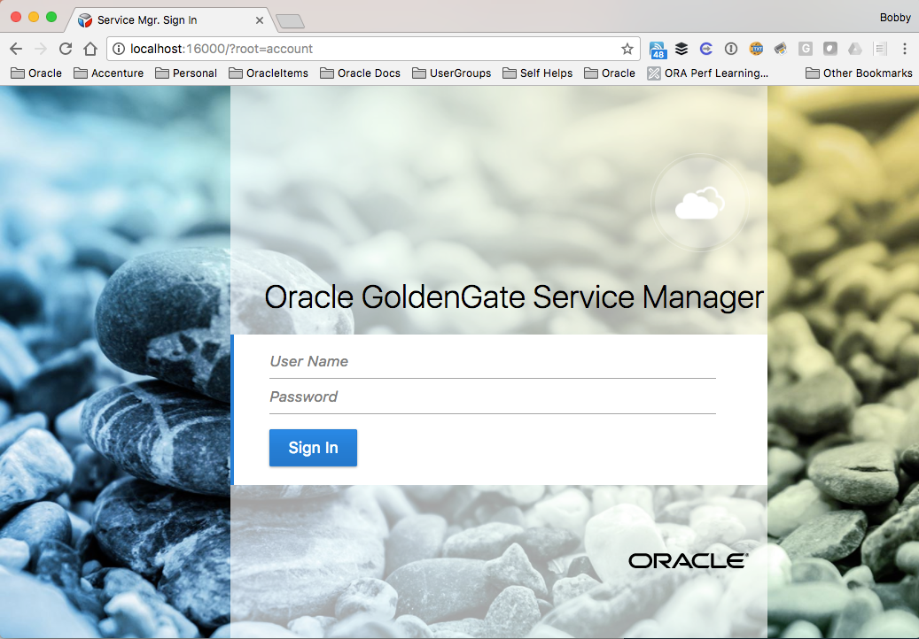
Web Interfaces
Access via URL http(s)://<hostname>:<port>

Slide 17
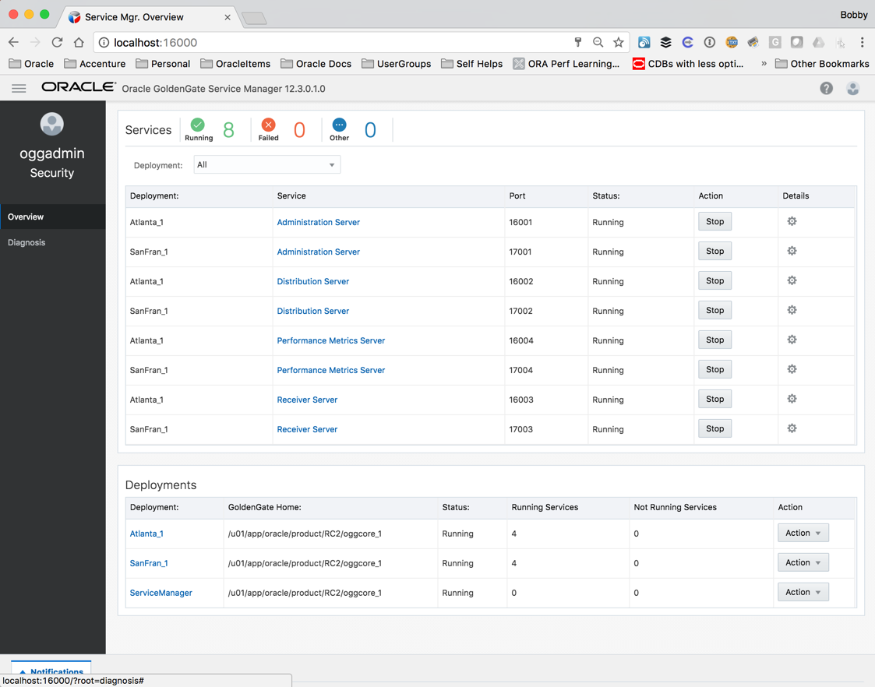
Oracle GoldenGate Service Manager
Access via URL (http(s)://<hostname>:<port>
i.e. http://localhost:16000
Use Administration User for access:
i.e. oggadmin/********
Maintains inventory and configuration information about all deployments
Watchdog process for Other OGG Services
Runs as a daemon
Auto-Restart
Inventory Info stored in /etc/oggInv.loc

Slide 18
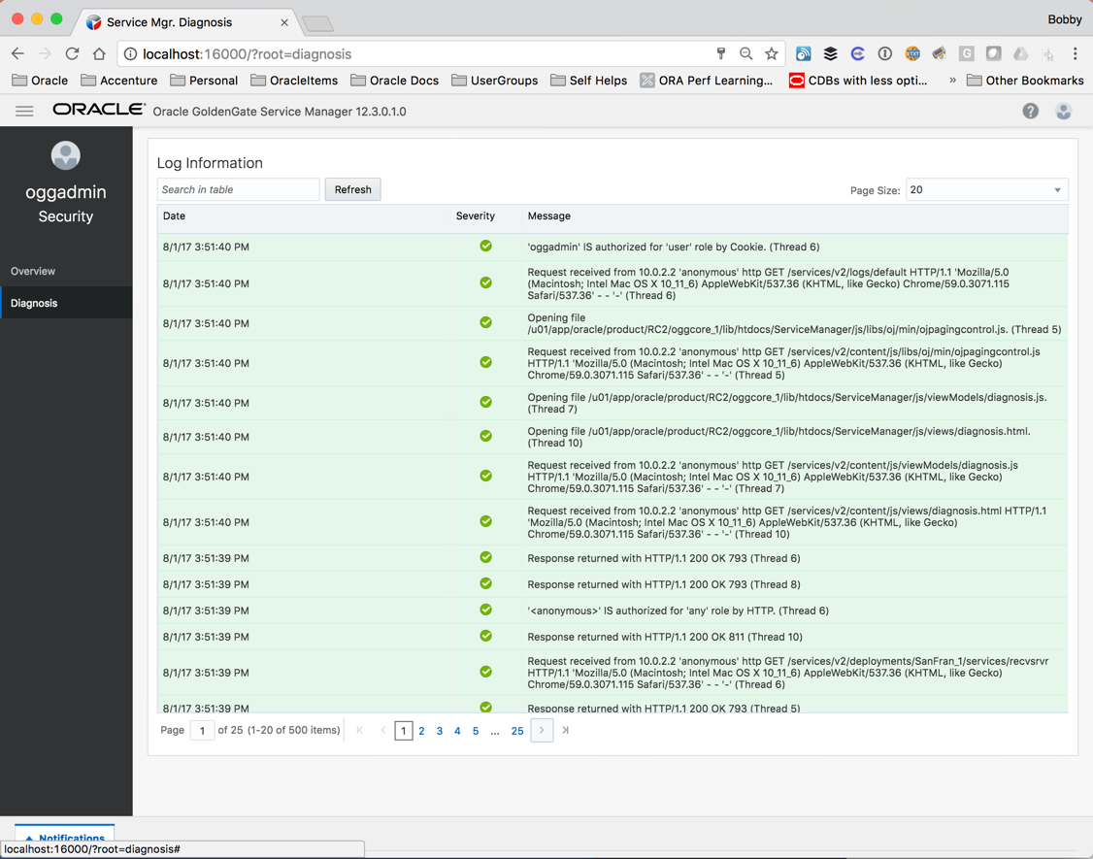
Oracle GoldenGate ServiceManager
Diagnostic Page
Provides access to responses that the ServiceManager receives
$OGG_DEPLOYMENT/var/log/ServiceManager.log

Slide 19
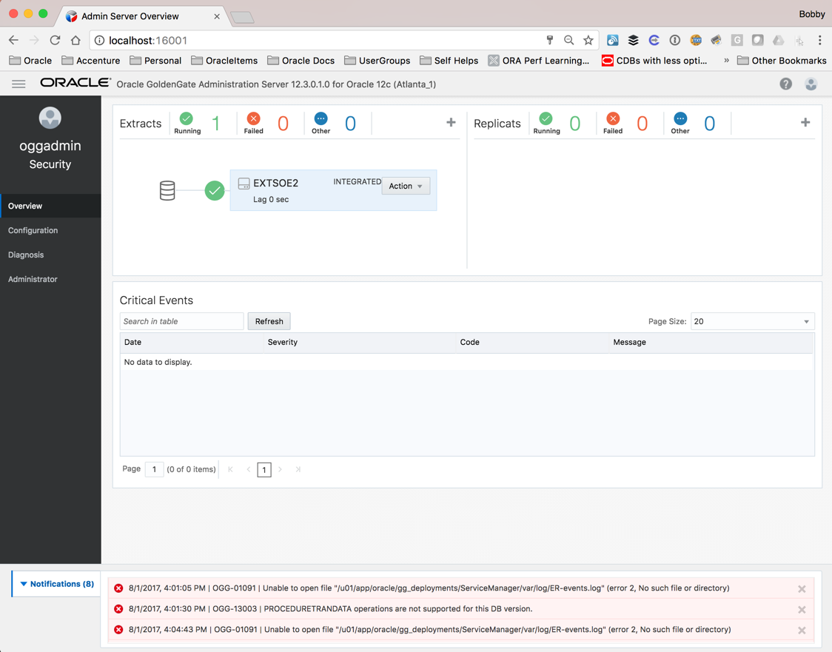
Oracle GoldenGate Administration Server - Overview
Access via URL (http(s)://<hostname>:<port>)
i.e. http://localhost:16001
Manage Extracts/Replicats
Create, delete, start/stop, reports, statistics
View critical events/messages
View notifications per page

Slide 20
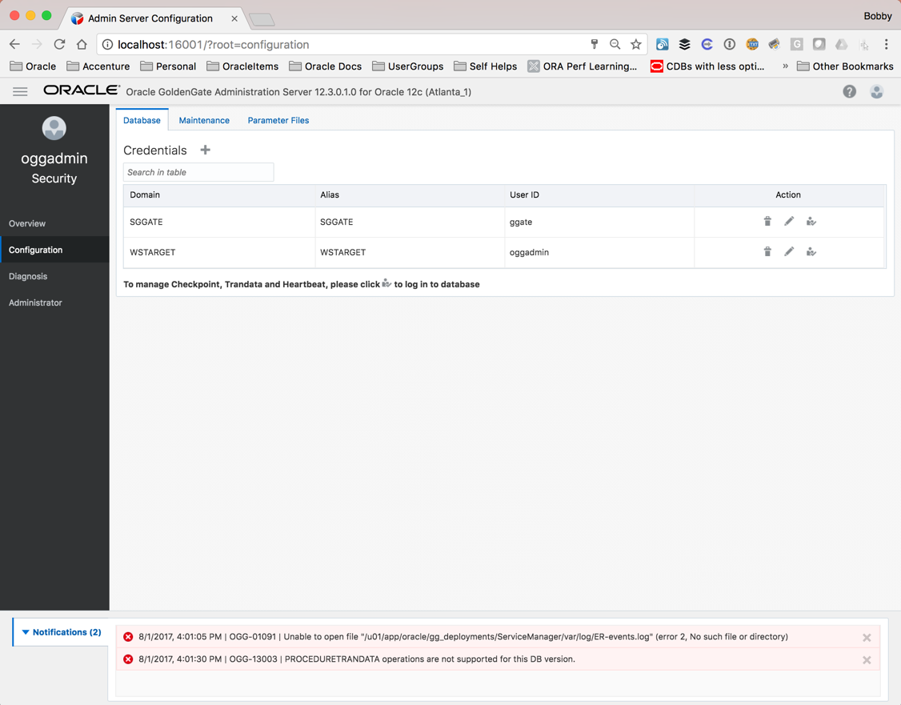
Oracle GoldenGate Administration Server - Configuration
Configure Credentials for replication
Database Logins
Protocol Logins
Manage specific GoldenGate specific DB functions
Checkpoint tables
Heartbeat tables
Credential stores
Supplemental Logging

Slide 21
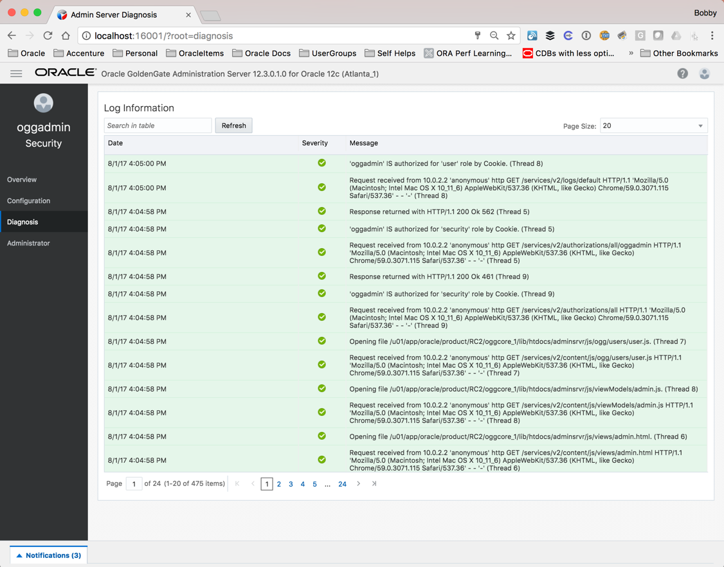
Oracle GoldenGate Administration Server - Diagnosis
Review log information in real-time
$OGG_VAR_HOME/log

Slide 22
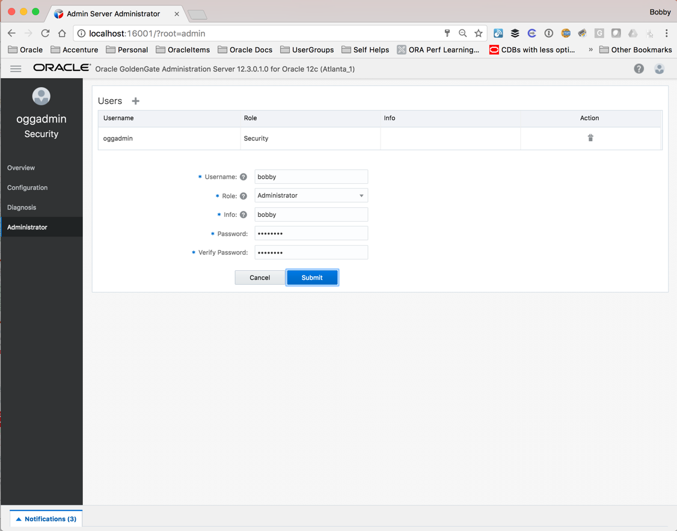
Oracle GoldenGate Administration Server - Administrator
Manage security of replication processes
Security role is highest privilege
Do not remove the MA admin (oggadmin – in this example)

Slide 23
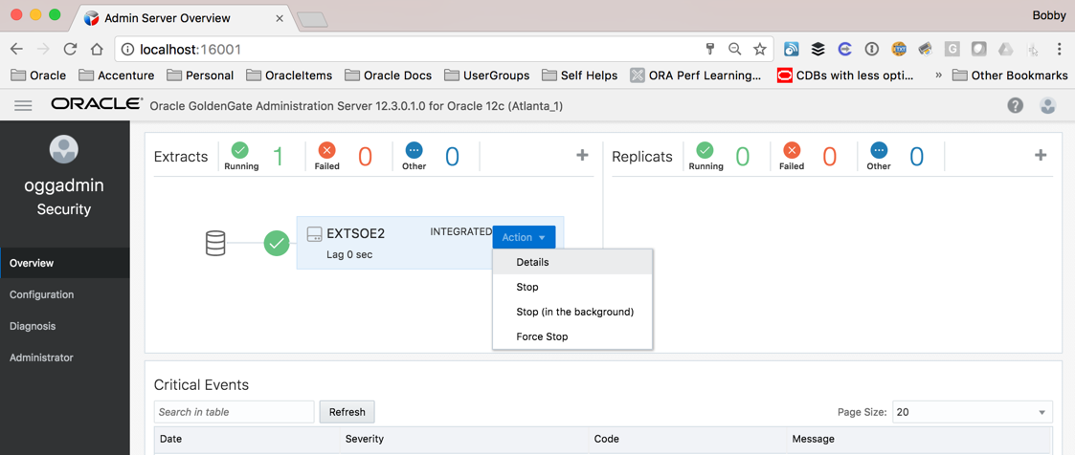
Oracle GoldenGate Administration Server - Details
Access to details for the process or service that is running

Slide 24
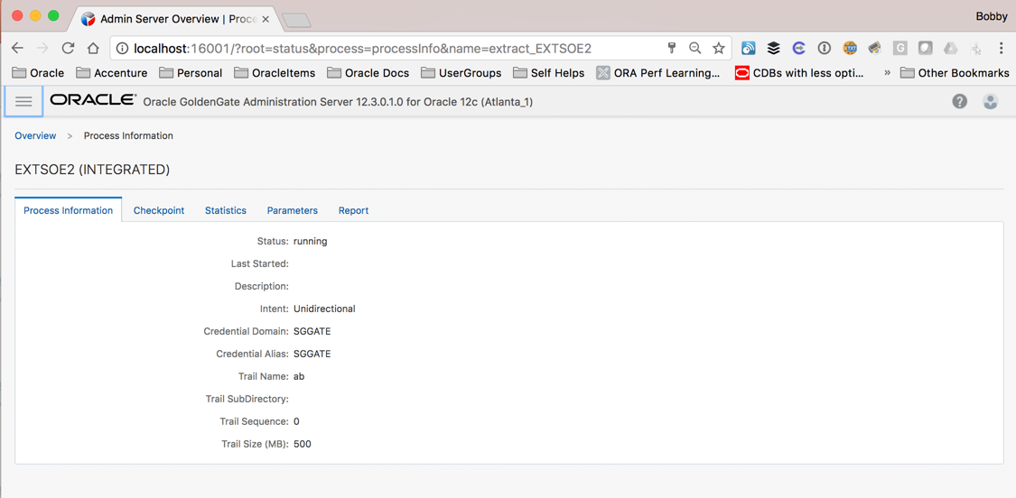
Oracle GoldenGate Administration Server - Details

Slide 25
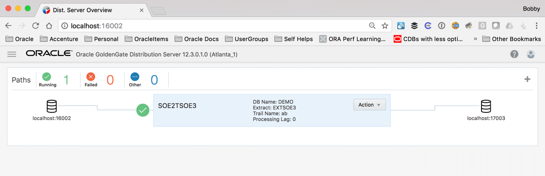
Oracle GoldenGate Distribution Server
Access via URL (http(s)://<hostname>:<port>)
i.e. http://localhost:16002
Replacement for the Extract Pump process
Quickly identify source, trail file, and destination
Distributes one or more trails to one or more destination
Does not support transformations
Supports multiple transport protocols
Tunable per network path

Slide 26

Communication Protocol
Industry standard HTTP(S) initiated full-duplex streaming protocol
Distribution Service
wss
ws
Receiver Service
udt
ogg
Trail Files
Extract
Trail Files
Replicat
SSL based security
Can seamlessly traverse through HTTP forward/reverse proxy servers

Slide 27
Protocol Choices for Distribution Server
WS
Plain Web Socket TCP/IP protocol using HTTP/HTTPS for handshake
Uses a “protocol user” in the source credential store for authentication.
Uses the ServerManager login credentials.
WSS - Secure Web Socket
WebSockets using TLS Security
This is the default protocol in the distribution service
Must use SSL certificates to implement channel between distribution and receiver services
UDT – User Datagram Transport
Used for long distance, low latency replication.
Aka “Far Sync” for GoldenGate
OGG – Oracle GoldenGate Protocol
Interoperability Protocol if you are using classic GoldenGate implementation.
Allows you to like new microservices implementation classic implementations
E.g GG Microservices Capture from Oracle to feed OGG 12.3 big data

Slide 28
WebSockets -- Default Data Communication Protocol
Industry standard HTTP(S) initiated full-duplex streaming protocol
wss://……/
Distribution Service
Receiver Service
Trail Files
Extract
Trail Files
Replicat
SSL based security
Can seamlessly traverse through HTTP forward/reverse proxy servers

Slide 29
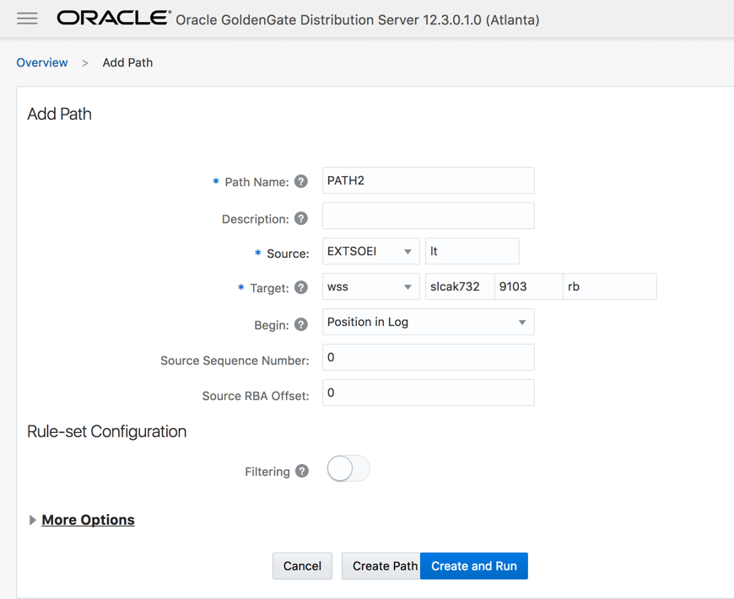
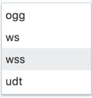
Oracle GoldenGate Distribution Server - Setup
Supports 4 transfer protocols – OGG, WS, WSS, UDT
Note: For WS/WSS, target credential needs to be setup that connects to the receiver service
UDT
UDP transport for wide-area networks
Faster than TCP over wide-area with high latency
OGG
inter-operability with traditional deployments

Slide 30
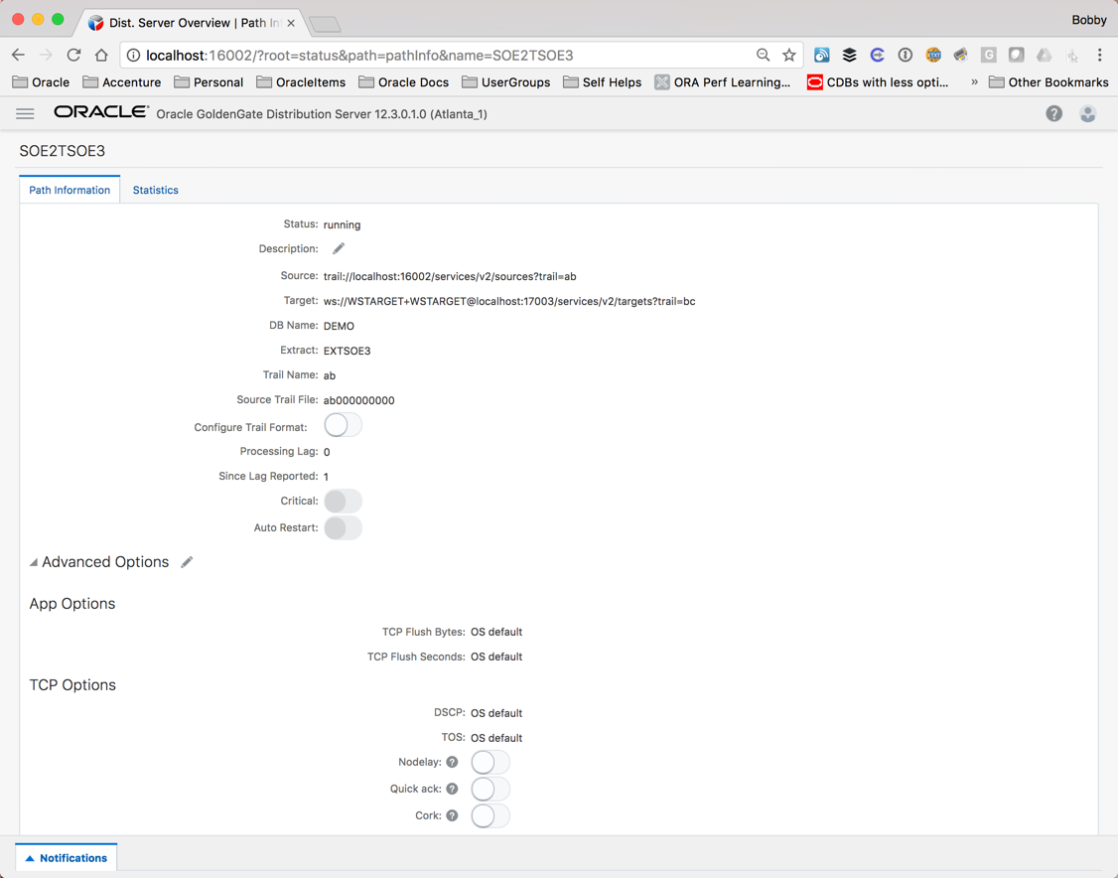
Oracle GoldenGate Distribution Server - Details
Quickly see path information
Status
Source/Target trails
DB Name
Trail name
Configure Application Options
Configure TCP Options

Slide 31
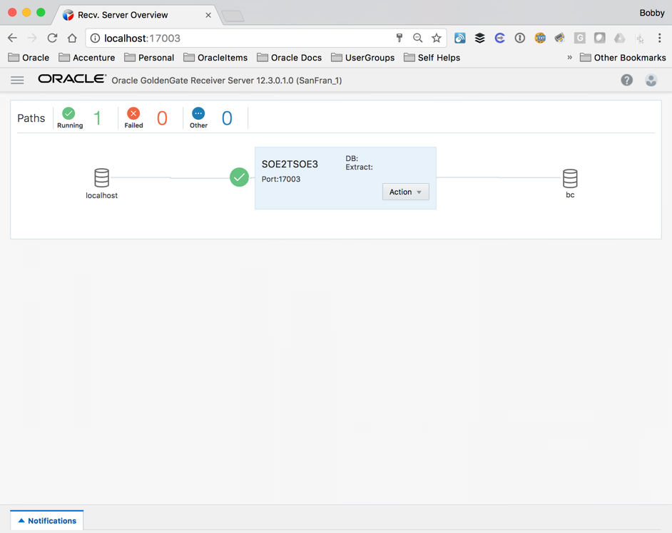
Oracle GoldenGate Receiver Server
Access via URL (http(s)://<hostname>:<port>)
i.e. http://localhost:17003
Replacement for Collector
Single source that handles multiple incoming trail files
View statistics of path
Tune network parameters

Slide 32
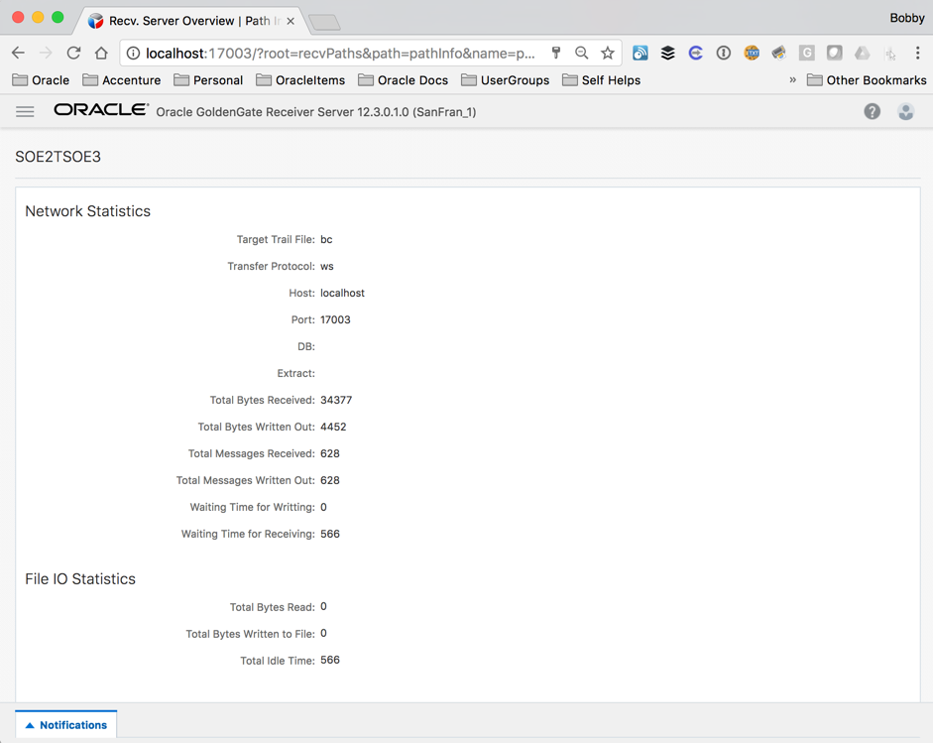
Oracle GoldenGate Receiver Server - Details
See Network Statistics and File IO Statistics
Statistics include:
Trail file name
Port
Bytes received
Bytes written out
Wait times

Slide 33
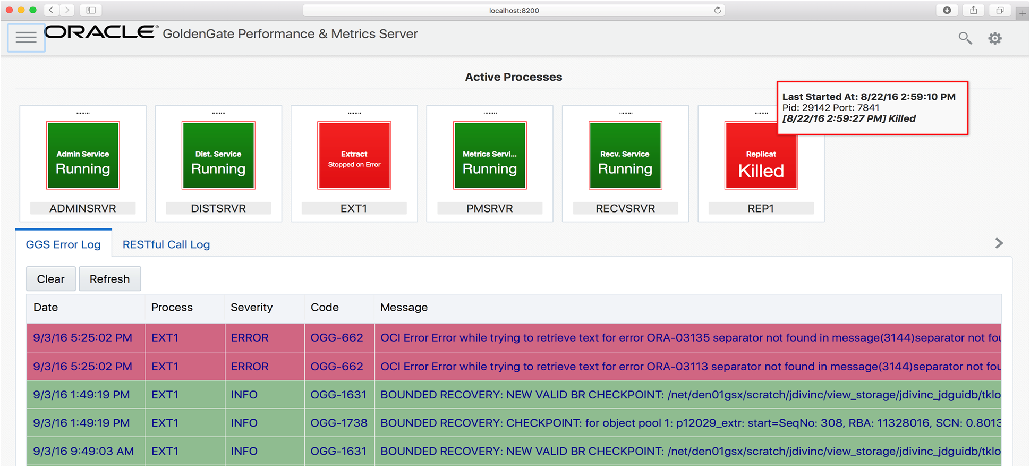
Performance Metrics Server
Metrics Service
Separate the metrics collection and repository from the administrative layer
All GoldenGate processes send metrics via UDP to the metrics server
Metrics server provide RESTful API to query metrics. Responses in either
12.2 XML format
New JSON format
Supports integration with third party tools
MUST have Oracle Management Pack for Oracle GoldenGate

Slide 34
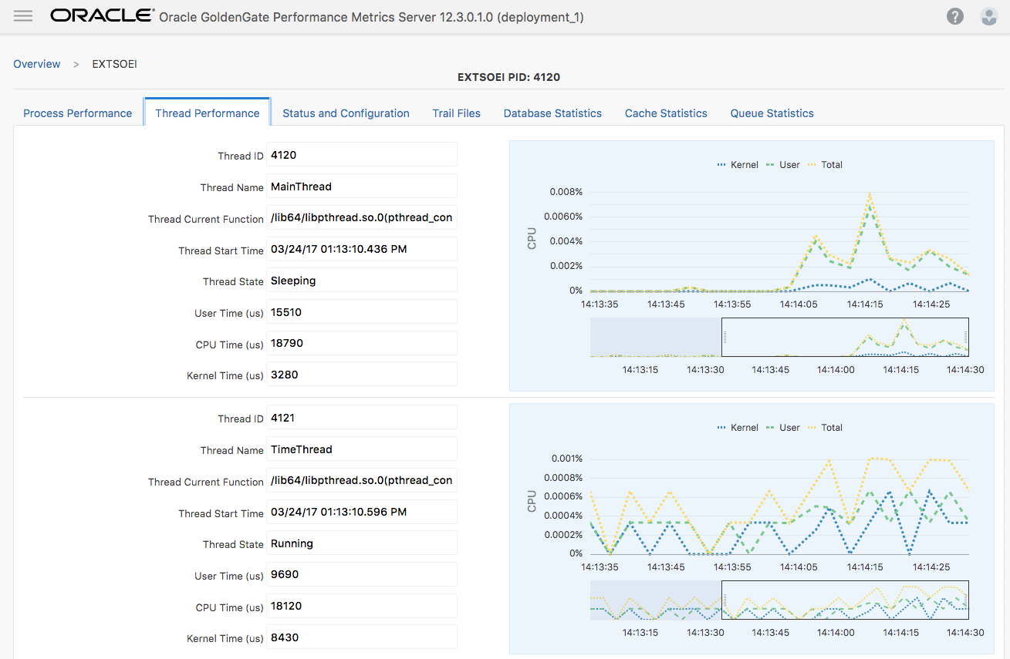
Oracle GoldenGate Metric Server
Metrics captured in real-time
Uses DBD or LMDB
No repository

Slide 35
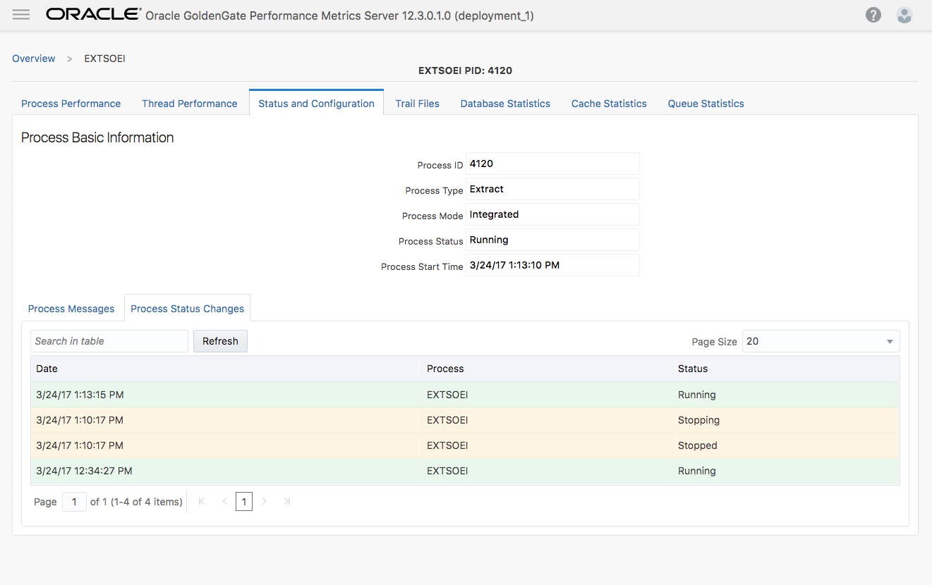
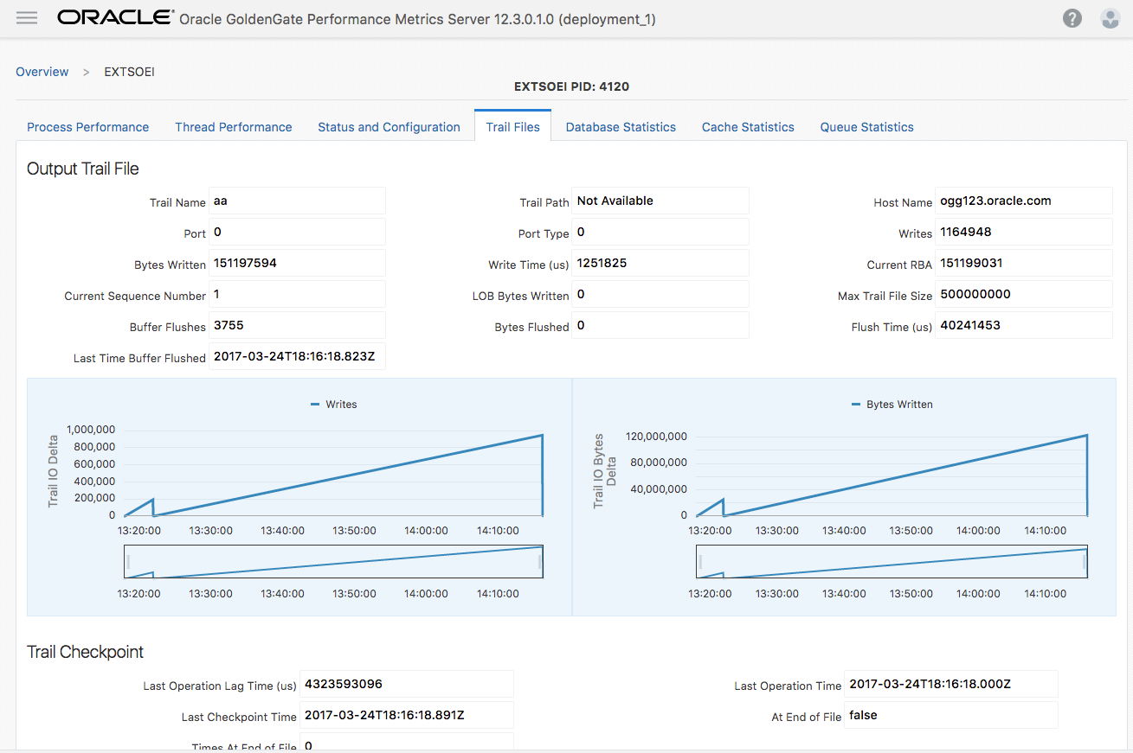
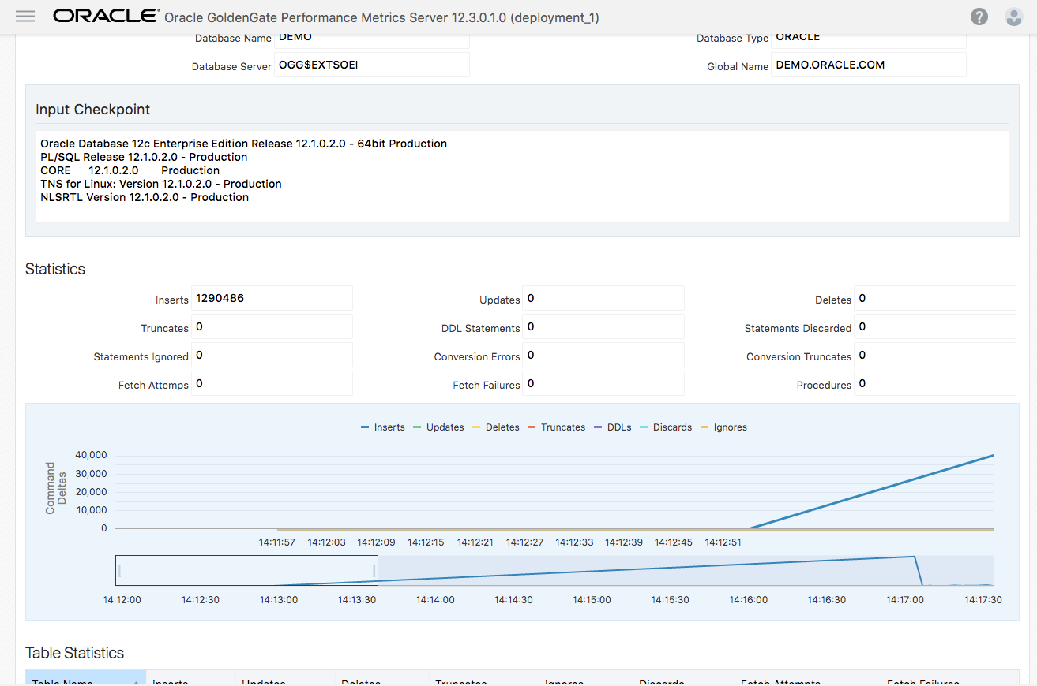
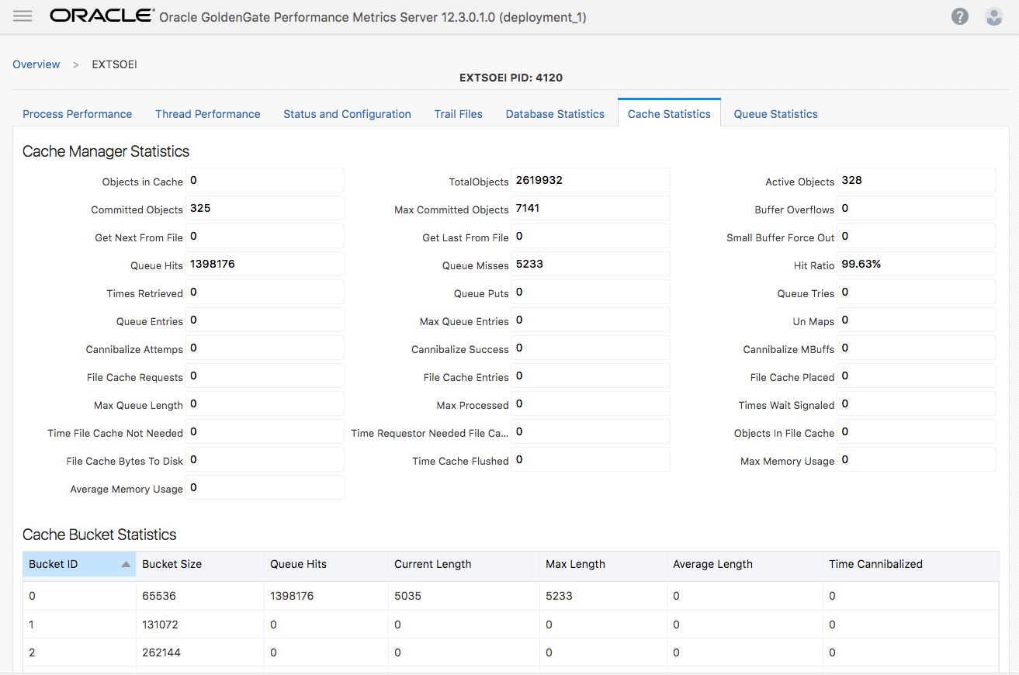
Oracle GoldenGate Metric Server

Slide 36
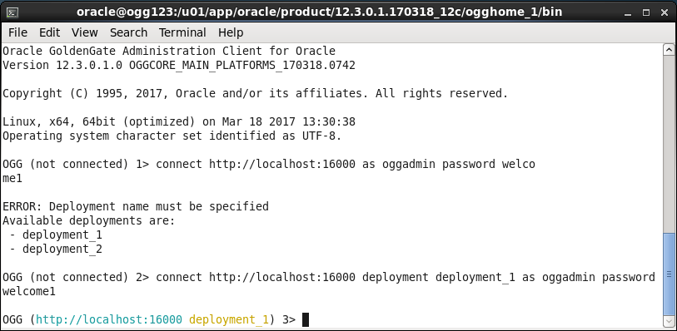
Oracle GoldenGate Administration Client (adminclient)
New thin client command line tool
Offers similar functionality as GGSCI, now includes rlwrap
Runs from $OGG_HOME/bin
$OGG_HOME can be on any machine, does not have to be directly on server
Supported on Windows and Linux

Slide 37
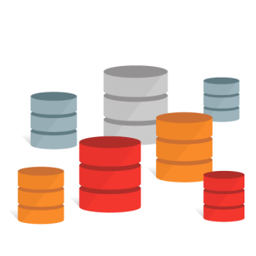
Administration Client (adminclient)
Interact with multiple deployments from a single command line tool
Runs from any machine using RESTful calls

Slide 38
AdminClient (connecting)
﻿[oracle@ogg123 sf_VM]$ ./adminclient
Oracle GoldenGate Administration Client for Oracle
Version 12.3.0.1.0 OGGCORE_MAIN_PLATFORMS_170318.0742
Copyright (C) 1995, 2017, Oracle and/or its affiliates. All rights reserved.
Linux, x64, 64bit (optimized) on Mar 18 2017 13:30:38
Operating system character set identified as UTF-8.
﻿GG (not connected) 1> connect http://localhost:16000 deployment Atlanta as oggadmin password ********
OGG (http://localhost:16000 deployment_1) 2>
Address and Port for Service Manager
Deployment to connect to
Administrator name and password

Slide 39
AdminClient (deployments)
[oracle@ogg123 bin]$ ./adminclient
Oracle GoldenGate Administration Client for Oracle
Version 12.3.0.1.0 OGGCORE_MAIN_PLATFORMS_170318.0742
Copyright (C) 1995, 2017, Oracle and/or its affiliates. All rights reserved.
Linux, x64, 64bit (optimized) on Mar 18 2017 13:30:38
Operating system character set identified as UTF-8.
OGG (not connected) 1> connect http://localhost:16000 as oggadmin password ********
ERROR: Deployment name must be specified
Available deployments are:
Atlanta
SanFran
OGG (not connected) 2>

Slide 40
AdminClient (help)
﻿OGG (http://localhost:16000 deployment_1) 3> help
Admin Client Command Summary:
! - Executes the previous command without modifications.
ADD CHECKPOINTTABLE - Creates a checkpoint table in a database.
ADD CREDENTIALSTORE - (Deprecated) Creates a credentials store (wallet) that stores encrypted database user credentials.
ADD DISTPATH - Creates a distribution path.
ADD EXTRACT - Creates an Extract group.
ADD EXTTRAIL - Adds a local trail to the Oracle GoldenGate configuration.
ADD HEARTBEATTABLE - Add a heartbeat table to the database
ADD MASTERKEY - Adds a master key to a master-key wallet.
ADD PROCEDURETRANDATA - Enables procedure-level supplemental logging.
ADD REPLICAT - Adds a Replicat group.
ADD RMTTRAIL - Adds a remote trail to the Oracle GoldenGate configuration.
ADD SCHEMATRANDATA - Enables schema-level supplemental logging.
ADD TRACETABLE - Creates a trace table.
ADD TRANDATA - Enables table-level supplemental logging.

Slide 41
AdminClient (info all)
oracle@ogg123 bin]$ ./adminclient
Oracle GoldenGate Administration Client for Oracle
Version 12.3.0.1.0 OGGCORE_MAIN_PLATFORMS_170318.0742
Copyright (C) 1995, 2017, Oracle and/or its affiliates. All rights reserved.
Linux, x64, 64bit (optimized) on Mar 18 2017 13:30:38
Operating system character set identified as UTF-8.
OGG (not connected) 2> ﻿connect http://localhost:16000 deployment deployment_1 as oggadmin password ********
OGG (http://localhost:16000 deployment_1) 3> info all
﻿Program Status Group Lag at Chkpt Time Since Chkpt
ADMINSRVR RUNNING
DISTSRVR RUNNING
PMSRVR RUNNING
RECVSRVR RUNNING
EXTRACT ABENDED EXTSOEI 00:00:09 00:00:00

Slide 42
Thursday’s Agenda
Overview
Microservices Architecture
Directory Structure
RESTful API

Slide 43
OGG 12.3 Deployment Options
Deployment Packages
Classic Architecture (CA) – Same as what you are using now where everthing is “self-contained” in the GG_HOME directory.
Microservices Architecture (MA) – Completely new architecture and deployment structure on disk
Note: Oracle 12c build supports both Oracle RDBMS 12.1 and 12.2
Upgrading to 12.3
Classic Architecture – as usual
Microservices Architecture – must be fresh install

Slide 44
Classic vs. Microservices Directory Structure
Classic $GG_HOME
Binaries
Libraries
dirprm
dirchk
dirrpt
dirdat
Microservices $GG_HOME
Executables
(bin)
Libraries (lib)
Utilities
Scripts
Microservices Deployments
Service Manager
Deployment N
Deployment N+1
...
etc
var
bin
etc
var
etc
var

Slide 45
Directory Overview
Old File System layout – Classic Architecture
$OGG_HOME is read-write
Can support multiple process groups but only one installation
Everything in one directory – remember CREATE SUBDIRS
Difficult upgrade path / overwrite binaries, manual moving file

Slide 46
Directory Overview
New File System layout – Microservices Architecture
$OGG_HOME should be read-only
One to Multiple deployments can share same $OGG_HOME
Deployment Homes can be customized
One step upgrade
New terms/variables to be used
DEPLOYMENT_HOME
$OGG_ETC_HOME / $OGG_VAR_HOME

Slide 47
New Directory Structure
$OGG_HOME
bin - Executables
lib – libraries, utilities, scripts
Deployment_Home (outside of $OGG_HOME)
$OGG_ETC_HOME - Config File, Sec. certs, wallets
$OGG_VAR_HOME - Logs, Trail File, …
Deployments (ServiceManager + N)

Slide 48
Oracle GoldenGate Home
No more just dumping in single directory
Now have a true “bin” and “lib” directories
Finally organized – similar to Oracle RDBMS
Should be read-only, but doesn’t need to be
Should be separate from deployment directories (more on this coming up)
Deployment homes cannot be built inside of $OGG_HOME
Easy patching without effecting running processes
$OGG_HOME
bin - Executables
cfgtoologs
deinstall
diagnostics
include
install
inventory
jdk
jlib
lib – libraries, utilities, scripts
Opatch
oraInst.loc
oui
srvm

Slide 49
Oracle GoldenGate Home - BIN
All executables are here
adminclient
adminsrvr
cachefiledump
checkprm
convchk
convprm
defgen
distsrvr
emsclnt
extract
ggcmd
keygen
logdump
oggca.sh
oggerr
orapki
pmsrvr
recvsrvr
replicat
retrace
ServiceManager
XAGTask
$OGG_HOME
bin - Executables
cfgtoologs
deinstall
diagnostics
include
install
inventory
jdk
jlib
lib
Opatch
oraInst.loc
oui
srvm

Slide 50
Oracle GoldenGate Home - LIB
All library files are here, along with:
crypto
ggMessage.dat
ggparm.dat
htdocs – html pages on services
info – text files for various help files
sql
healthcheck
legacy
sharding
tcperrs
utl
install
logging
reverseproxy
sharding
$OGG_HOME
bin
cfgtoologs
deinstall
diagnostics
include
install
inventory
jdk
jlib
lib – libraries, utilities, scripts
Opatch
oraInst.loc
oui
srvm

Slide 51
Oracle GoldenGate Deployment Home(s)
Deployment homes can be anywhere
Must have an etc and var (OGG creates)
Customizable directories
Configured through OGGCA or silent installation
New environment variables
$OGG_ETC_HOME
$OGG_VAR_HOME
Environment variables needed for many things
Services
AdminClient
Deployment Homes
$OGG_ETC_HOME
$OGG_VAR_HOME

Slide 52
Oracle GoldenGate Deployment Home - ETC
1 of 2 base folders for a deployment
Customizable
Configured through OGGCA or silent installation
Housed items, such as
Configuration Files (conf)
Secure Socket Layer (SSL) certs (ssl)
Logs (logging)
ogg (params and GLOBALS)
deploymentConfiguration.dat
Deployment Homes
$OGG_ETC_HOME
$OGG_VAR_HOME

Slide 53
Oracle GoldenGate Deployment Home - VAR
2 of 2 base folders for a deployment
Customizable
Configured through OGGCA or silent installation
Housed items, such as
Library Files (lib)
check points (*.cp*)
config (*.dat)
credential (wallet.sso & secureStore)
data (trail files)
db (dirbdb)
def (definition files)
distpaths (*.cpe (mappings))
info
report (discard (*.dsc) & report (*.rpt))
sql (sql files)
wallet
www
Deployment Homes
$OGG_ETC_HOME
$OGG_VAR_HOME

Slide 54
Oracle GoldenGate Deployment Home – VAR (con’t)
2 of 2 base folders for a deployment
Housed items, such as
Lock Files (lock)
Log Files (log)
*.log
Run Items (run)
BR
*.pc*
Temp Files (temp)
globalCfg.json – monitoring information configured
Deployment Homes
$OGG_ETC_HOME
$OGG_VAR_HOME

Slide 55
Oracle GoldenGate Service Manager
3 base folders for a deployment
bin
startSM.sh
stopSM.sh
etc
var
Location Customizable
Configured through OGGCA or silent installation
New environment variables
$OGG_ETC_HOME
$OGG_VAR_HOME
Best Practice – Name directory: ServiceManager
Deployment Homes

Slide 56
Thursday’s Agenda
Overview
Microservices Architecture
Directory Structure
RESTful API

Slide 57
Oracle GoldenGate RESTful APIs
Representational State Transfer (RESTful) Application Program Interface (API)
Uses HTTP requests
GET, PUT, POST, and DELETE
Can be used with many different programming languages
PL/SQL
Perl
Shell
JSON
Etc…
Simple interaction from command line using CURL (examples coming up)

Slide 58
Oracle GoldenGate RESTful APIs – JSON Documents
JavaScript Object Notation (JSON)
An open-standard file format used to transmit data objects consisting of attribute-value pairs and array data types
Media Type: application/json
Example – create credential alias:
{
"$schema":"ogg:credentials",
"userid":"ggate",
"password":"ggate"
}

Slide 59
Oracle GoldenGate RESTful APIs – GET
GET option allows you to retrieve items back from a service
Example – GET associated services
,...
"messages": [],
"response": {
"$schema": "ogg:collection",
"items": [
{
"$schema": "ogg:collectionItem",
"links": [
{
"href": "http://localhost:16000/services/v2/deployments/Atlanta_1/services",
"mediaType": "application/json",
"rel": "parent"
},
{
"href": "http://localhost:16000/services/v2/deployments/Atlanta_1/services/adminsrvr",
"mediaType": "application/json",
"rel": "canonical"
}
],
"name": "adminsrvr"
}
....
curl -u oggadmin:welcome1 -H "Content-Type:application/json" -H "Accept:application/json" -X GET http://localhost:16000/services/v2/deployments/Atlanta_1/services | python -mjson.tool

Slide 60
Oracle GoldenGate RESTful APIs – POST
POST allows you to add items to the environment
Example – POST a new credential
,…
"messages": [
{
"$schema": "ogg:message",
"code": "OGG-15114",
"issued": "2017-08-10T12:40:54Z",
"severity": "INFO",
"title": "Credential store in /opt/app/oracle/gg_deployments/Atlanta_1/var/lib/credential/ altered.",
"type": "http://docs.oracle.com/goldengate/c1230/gg-winux/GMESG/oggus.htm#OGG-15114"
},
{
"$schema": "ogg:message",
"code": "OGG-15116",
"issued": "2017-08-10T12:40:54Z",
"severity": "INFO",
"title": "No information found in credential store.",
"type": "http://docs.oracle.com/goldengate/c1230/gg-winux/GMESG/oggus.htm#OGG-15116"
}
]
}
curl -u oggadmin:welcome1 -H "Content-Type: application/json" -H "Accept: application/json" -X POST http://localhost:16001/services/v2/credentials/OracleGoldenGate/SGGATE -d @create_cred_alias.json | python -mjson.tool

Slide 61
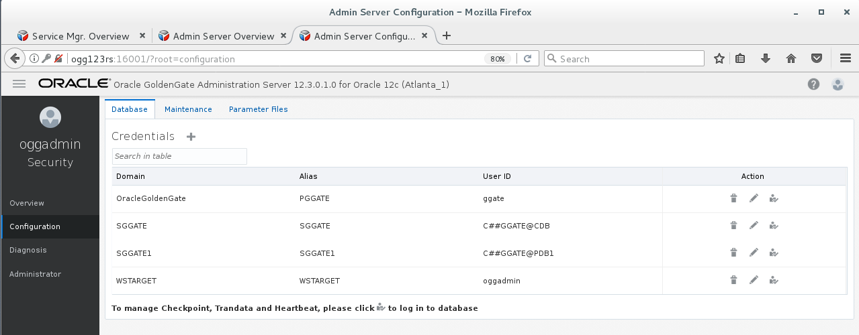
Oracle GoldenGate RESTful APIs – POST
POST allows you to add items to the environment
Example – POST a new credential
Notice Domain, Alias and UserId added

